Slide 1

Team 5 : MID-WEST CAR RENTALS
Team Members:
Kedar Kaushikkar

Slide 2

Introduction and Description
A car rental, hire car, or car hire agency is a company that rents automobiles for short periods of time, generally ranging from a few hours to a few weeks.
Car rental companies operate by purchasing or leasing a number of fleet vehicles and renting them to their customers for a fee.
In our Project we are building an interface between car rental companies and their customers.
We have proposed a system to provide ease of access to the customers in searching , locating, booking , and paying for a car, as well as to the admin to add/update/delete catalog of product, manager customers account, manager customer’s bookings.
Proposed Model has two modules in it named as : ADMIN and USER.

Slide 3


Requirements : User
A user can create an account by signing up. Every new user gets a promo code via mail when he signs up to get discount of $25 on his first booking.
After registration , he can login into his account and search car availability by location, date, time and duration. Here AJAX will be used for auto-populating data in search fields.
Only users above 18 years of age can rent a car. Validations to check the same.

Slide 4


Requirements : User
Once any user finds a suitable car, he can proceed to payment’s page for further processing. After providing necessary details like personal info ,type of card, card number etc payment action is performed. Here dummy credit card numbers will be used for testing.
A user can anytime update his profile though settings page.
A user can cancel his booking according to cancellation policies of car rental agency.
He can refer this website to his friends and family. This will be done via sending emails to them.
User can also give ratings and write reviews for the vehicles or services or any other offers he got from the agency.

Slide 5

Requirements : Admin
Admin acts as a manager of site and is responsible for any managerial task required.
He can add new cars , delete existing cars, update their prices and other information e.g. insurance , discounts , offers etc.
He manages bookings of users e.g. increasing duration for a rented car on request, cancel a booking etc.

Slide 6




Technology Used
HTML , CSS, Servlets, JSP, BOOTSTRAP
DataBase : MongoDB

Slide 7
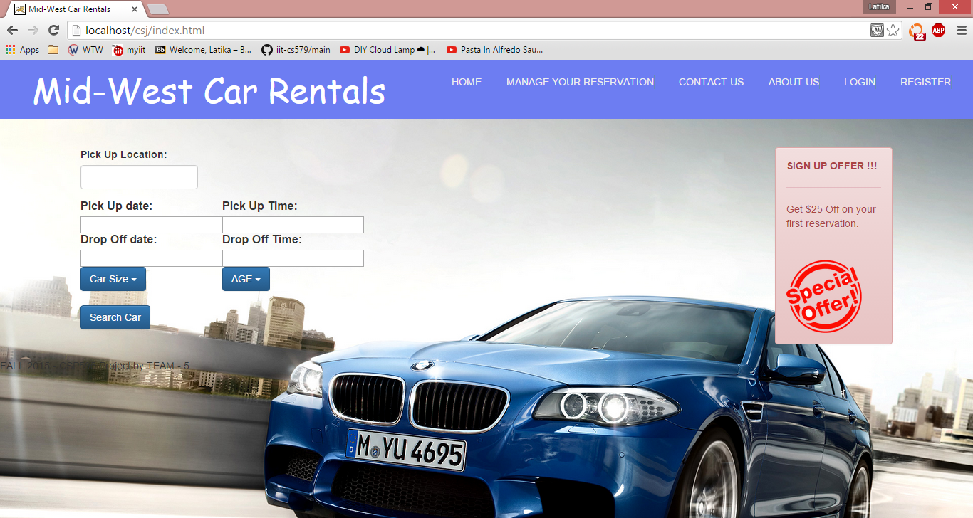
HOME PAGE

